Slide 1
Ruby on Rails
Controllers
Routes
Oleksii Zaitsev
16.02.2012

Slide 2
Agenda
MVC
Controllers
Routes

Slide 3
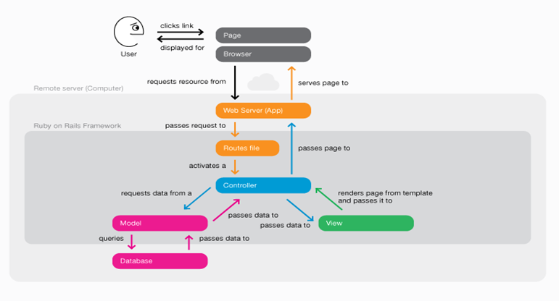
MVC

Slide 4
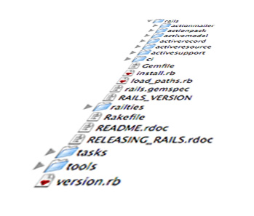
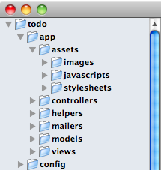
Controller
Controllers are the C in MVC.
They’re in charge of the flow of the program: They gather information and make it available to the views.
Views and controllers are tightly coupled to one another.
Names you choose for your variables in the controller will have an effect on what you do in the view.

Slide 5
ActionController
In Rails, your application’s controller and view layers use the Action Pack
components of Rails. Controllers are implemented using the ActionController component of Action Pack. The ActionController component provides you with
an easy-to-use functionality related to the following areas:
Routing
Interfacing with the Web server
Using sessions
Cache management
Rendering view templates

Slide 6
ApplicationController
By default, only the ApplicationController in a Rails application inherits from ActionController::Base. All other controllers in turn inherit from ApplicationController. This gives you one class to configure things such as request forgery protection and filtering of sensitive request parameters.

Slide 7
Methods and Actions
A controller is a Ruby class which inherits from ApplicationController and has methods just like any other class. When your application receives a request, the routing will determine which controller and action to run, then Rails creates an instance of that controller and runs the method with the same name as the action

Slide 8
Lets generate a controller
> rails generate controller Project index
create app/controllers/project_controller.rb
route get "project/index"
invoke erb
create app/views/project
create app/views/project/index.html.erb
invoke test_unit
create test/functional/project_controller_test.rb
invoke helper
create app/helpers/project_helper.rb
invoke test_unit
create test/unit/helpers/project_helper_test.rb
convention over configuration!

Slide 9
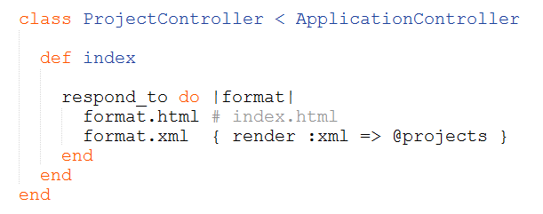
Methods and Actions
As an example, if a user goes to /projects/index in your application, Rails will create an instance of ProjectsController and run the index method.

Slide 10
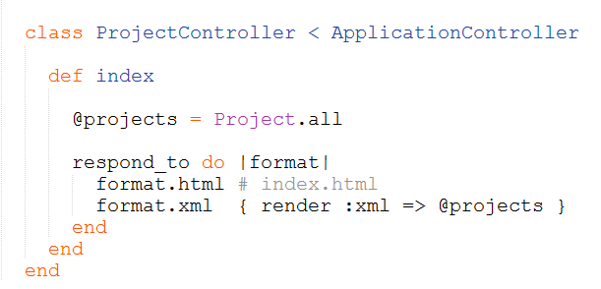
Variables

Slide 11
Using request parameters
Many of the requests that your action methods will receive will contain request parameters submitted by the browser, which you will need to process the requested action. This includes parameters submitted in a URL using an HTTP GET request, and parameters contained in the HTTP header of a POST request. As an example, assume the following URL is passed to your Rails application:
http://www.myapp.com/projects/show/123
Using the default route, Rails will route this request to the show method of your ProjectController class. A user id is also passed to the show method. The show method should look up the user identified by that user id and display details about that user.

Slide 12
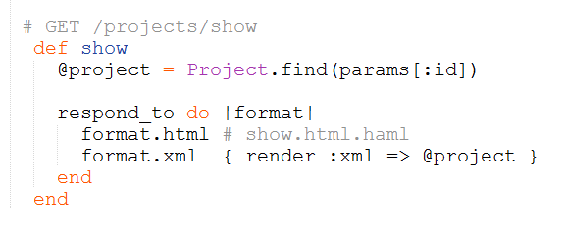
Using request parameters
Rails makes all of the request parameters available through a params hash.

Slide 13
Rendering templates
Rails templates define the views of your Rails application. At the end of your action, you typically will render a template to return a new Web page to the user.

Slide 14
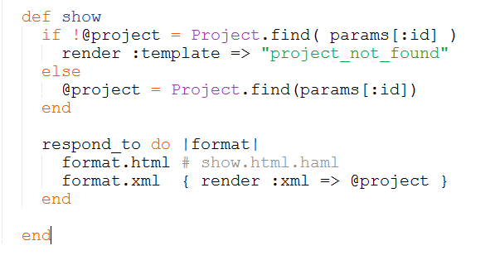
Rendering templates

Slide 15
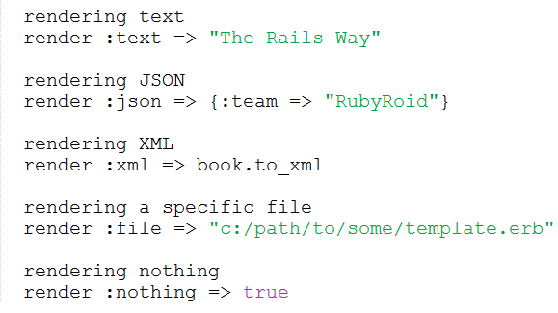
Sending other data types

Slide 16
Redirects
In addition to rendering a template, Rails also has built-in functionality that allows you to easily send a redirect to the browser. Let’s look at an example of where you might want to use a redirect:

Slide 17
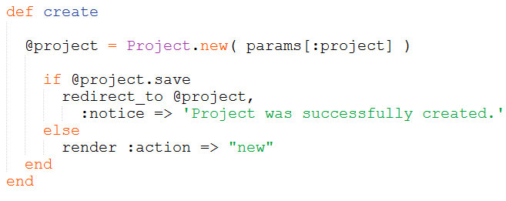
Redirects

Slide 18
Sending feedback with flash
The flash feature of Rails is a way of passing simple feedback messages from your application back
to the browser.
Data that is stored into the flash is kept for the duration of one action, and then it is removed. The
flash is a convenient place to store short status messages that need to be communicated from one
action to the next. Examples of where flash is commonly used include displaying results of a login
attempt, results of a file upload, or results of a form submission.

Slide 19
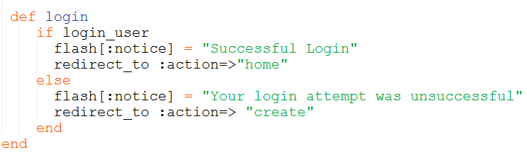
Sending feedback with flash

Slide 20

Routes in Rails

Slide 21
Routes in Rails
The Purpose of the Rails Router
The Rails router recognizes URLs and dispatches them to a controller’s action. It can also generate paths and URLs, avoiding the need to hardcode strings in your views.

Slide 22
Routes in Rails
Connecting URLs to Code
When your Rails application receives an incoming request
GET /projects/17
it asks the router to match it to a controller action. If the first matching route is
the request is dispatched to the projects controller’s show action with
{ :id => “17” } in params.

Slide 23

CRUD, Verbs, Actions
A single entry in the routing file, such as
creates seven different routes in your application, all mapping to the Photos controller:

Slide 24
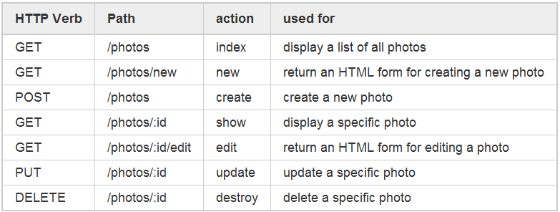
CRUD, Verbs, Actions

Slide 25
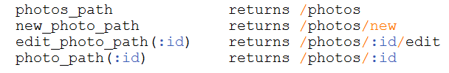
Paths and URLs
Creating a resourceful route will also expose a number of helpers to the controllers in your application. In the case of resources :photos:

Slide 26

Nested Resources
Nested routes allow you to capture this relationship in your routing. In this case, you could include this route declaration:
This will also create routing helpers such as magazine_ads_url and edit_magazine_ad_path. These helpers take an instance of Magazine as the first parameter
magazine_ads_url(@magazine)
Resources should never be nested more than 1 level deep!

Slide 27
Creating patchs and URLs
In addition to using the routing helpers, Rails can also create paths and URLs from an array of parameters

Slide 28
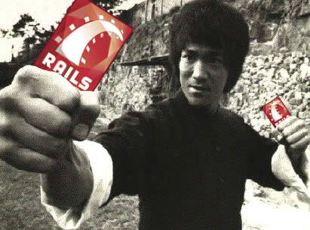
The Rails Way

Slide 29

Questions?

Slide 30
Links
http://guides.rubyonrails.org/
http://railscasts.com/
http://rusrails.ru/

Slide 31
Contacts
Europe Headquarters
52 V. Velykoho Str.
Lviv 79053, Ukraine
Tel: +380-32-240-9090 Fax: +380-32-240-9080
E-mail: info@softserveinc.com
Website: www.softserveinc.com
US Headquarters
12800 University Drive, Suite 250 Fort Myers, FL 33907, USA
Tel: 239-690-3111 Fax: 239-690-3116
Thank You!
Copyright © 2010 SoftServe, Inc.

